Slide 1

Department Of Computer Science

Slide 2
Final Report Presentation Speech2Face Application
Shahzaneer Ahmed
CUI/SP21-BCS-087/ISB
Shayan Zameer
CUI/SP21-BCS-088/ISB
Supervisor:
Mr. Tehseen Riaz Abbasi
Department Of Computer Science
Submission Date: (31st dec 2022)

Slide 3
Abstract
Speech2face is a project that is mainly built to recognize the face general structure and gender with audio waves.
There is no full fledge software in the world that helps in regard although there are deep learning libraries on which work is done in the past.
It is nearly impossible to predict the appearance of same person with his/her voice. But artificial Intelligence has made it.
It will automate the attendance system and reinvigorate the authentication system.
It will prove an asset to the security and agencies by recognizing criminals.
It can also be used as a general-purpose software for recognizing the individuals in old audios and images.

Slide 4
Project Category
Project Categories are
B- Web Application/Web Application based Information System
C- Problem Solving and Artificial Intelligence
E- Smartphone Application
H-Image Processing

Slide 5
Introduction
Recognizing the facial features of person based on their audio notes by a human being who don’t actually know the person make no sense in real life.
There is no way to do so But Artificial Intelligence has made it possible to do so.
The Machine learning and deep learning can be trained on data of all type of people with some mathematical perspectives of voice that uses clustering algorithms and categorize the people in different domains.
The image will not be 100% real but it gives a lot of insights of data which can help us to identify the person.

Slide 6
Problem Statement
There are many loop holes in the user authentication used in security systems including banks, critical profile accounts and many more places where authenticity of user should be the first priority.
Every other person who has the credentials of the account of that specific user can log into the account specified merely for the former.
In case of criminals Scenes, It is observed that the faces are not recognized hence the criminals are not captured by the security forces.
Mostly the voice can be seen but the faces are under veil thus cannot be seen directly.

Slide 7
Problem Solution
Many Application users and Agencies have requested system that are helpful, efficient and reliable in user authentication.
Speech2face will provide an acceptable solution to these concerns.
Security agencies face many problem sometimes because image of criminals are not revealed by the camera. Speech2face will help in this regard.
The old audio and video notes can be used to find the insights about the person’s basic information.

Slide 8
Vision Statement
For users who want to authenticate their systems and find a visual representations of voices depending upon different factors .
Speech2face is an application that will help in authenticating users and finding real time insights about voices unlike the data analyzed model which are not in practical usage form.
The user will user our application and will be able to transform the audios into images and gain generic information about the person whose voice is under observation.

Slide 9
Related System Analysis/Literature Review
The related system analysis and literature review of other applications related to our project are given below:
Application Name | Weakness | Proposed Project Solution
Sound Classification | There are too many sounds so there is a possibility that system can’t get sound and displays result according to need | The application deals with sound and converts int facial images. The risk is low as compared to related project.
Face net | There are number of areas that are still left to be explored and how different ages and race play a role in face recognition.
Speech2face | No Mobile application, only available as a website | The application will be available on web as well as mobile application.

Slide 10
Advantages/Benefits of Proposed System
Following are the advantages of our application:
Privacy of person is there because the resemblance is apparently not 100% right.
The application helps investigation teams to get an idea how the criminals look like by using their voice.
We evaluate and numerically quantify how and in what matter reconstruction from audio resemblance the true face of speaker.

Slide 11
Scope
The application will be designed to provide coordination among the interaction between image and voice i-e how voice will be converted to image.
Profile Management: The users will have to register and then sign into the system to use it. His record will be saved against his ID.
Chat bot: There is an intelligent chatbot that will help the user to get started with the application and will guide about usage.
Post-Voice record Management: The user can record voice, add previously existing voice , update it and delete it. It will be analyzed by the ML model.
Vector to Vector Model: The voice is the extracted and converted to the vector model with the help of machine learning and AI.
Vector Model to Vector-Image Model: The generated vector model is taken as input for this module and It is converted to image form using the power of AI.
Help and Support: User’s queries will be resolved through an AI bot and If it is unable to resolve query then user will have option to live chat with the support team.

Slide 12
Scope
Review Module: As the project is R & D based therefore it is not 100% possible for the system to detect the correct insights. Therefore, the system will prompt the user to give his feedback and it will improve itself according to the reviews given by users.
Insights Module: It Opens a page to the insights that are obtained by the voice notes including predicted age, race, nose type, facial features details, etc.

Slide 13
Modules
The modules of the project are listed below:
Module 1: Profile Management
Module 2: Place Voice Record
Module 3: Sound to Face Vector Model
Module 4: Face-Vector to Face-Image Model
Module 5: Image View Customization
Module 6: Features Enhancer.
Module 7: Insight Panel
Module 8: Settings and Configuration
Module 9: Help and Support

Slide 14
Module-1: Profile Management
The main functions of this modules are:
MF-1 Sign Up
MF-2 Log In
MF-3 Sign in as Guest
MF-4 Sign Via Phone
MF-5 Sign Via Voice
MF-6 Update profile Information
MF-7 Delete Profile
MF-8 Logout

Slide 15
Module-2: Place Voice Record
The main functions of this modules are:
MF-1 Record voice
MF-2 Upload existing voice
MF-3 Upload existing video to fetch voice
MF-4 Update video
MF-5 Update voice
MF-6 Delete Voice
MF-7 Delete video

Slide 16
Module-3: Sound to Face-Vector Model
The main functions of this modules are:
MF-1 Sound to vector modeling via Deep Learning
MF-2 Generate vector Model

Slide 17
Module-5:Image View Customization
The main functions of this modules are:
MF-1 Brightness Control
MF-2 Saturation Management
MF-3 Skin Color Management
MF-4 Filters

Slide 18
Module-6: Features Enhancer
The main functions of this modules are:
MF-1 Face Shape Enhancement
MF-2 Nose Enhancement
MF-3 Eyebrow Enhancement
MF-4 Beard Maker
MF-5 Eye Enhancement

Slide 19
Module-7: Insight Panel
The main functions of this modules are:
MF-1 View Report
MF-2 Download Report
MF-3 Share on Socials

Slide 20
Module-8: Setting and Configuration
The main functions of this modules are:
MF-1 Rate Result.
MF-2 Feedback in terms of words
MF-3 System lagging checks
MF-4 Change Language
MF-5 Dark mode

Slide 21
Module-9: Help and Support
The main functions of this modules are:
MF-1 Chat With Bot
MF-2 Contact Support Team
MF-3 Change Bot’s Language
MF-4 View Bot Query History

Slide 22
System Limitations
Following are the limitations of our proposed system:
The System cannot predict the image 100% correct.
The System is unable to guess some voices if it consists of type on which the data is not trained.
The System can be accessed over the internet.

Slide 23
Software Process Methodology
Process Methodology
The software process methodology that we will use is Iterative Process Model.
Our application has finite number of functionalities and most of the requirements are surely not known.
The project is not very common and is research and development based.
Therefore, the most suitable process model we could select is iterative process model
Design Methodology
The design methodology we will be using is Object Oriented Approach because it increases the reusability of the code, and it would be easier for the team members to work together without any confusion.
Therefore, we are using Dart for Flutter, HTML, CSS languages which follows object-oriented approach.
Also, it is easier to describe the code using UML diagrams. So, OOP is the best approach which fits our framework.

Slide 24
Tools and Technologies
The tools and technologies that will be used in the project are provided in the table below
Tools And Technologies | Tools | Version | Rationale
 | MS Visual Studio Code | 2022 | IDE
 | Git | 2020.3.4 | IDE
 | MS Word | 2021 | Documentation
 | MS Power Point | 2021 | Deployment
 | Netlify | 2022 | Mockups Creation
 | Flutter | 3.3 | SDK
 | Figma | 2022 | Mockups Creation
 | MS Visual Studio Code | 2022 | IDE
 | Technology | Version | Rationale
 | Dart | 3.55 | Client -side Scripting
 | Firebase | 5 | Ready Made Backend
 | Html | 5 | Web Structuring
 | CSS | 3.0 | Web Design
 | JavaScript | ECMA Script 2017 | Event Based Programming language
 | Python | 3.8 | ML/DL programming language

Slide 25
Project Stakeholders and Roles
The Stakeholders of the project are:
Project Sponsor | RaviCom Solution Private Limited
Stakeholder | Shahzaneer Ahmed. Shayan Zameer Project Supervisor Name: Mr. Tehseen Riaz Abbasi.

Slide 26
Team Members Individual Tasks/Work Division
The Task Distribution is as follows:
Student Name | Student Registration Number | Responsibility/ Modules
Shahzaneer Ahmed | SP21-BCS-087 | (Module1-Module3-Module5-Module7-Module9) Mobile App, Documentation, Backend, ML,DL
Shayan Zameer | SP21-BCS-088 | Idrees Ghazi (Module2-Module4-Module6-Module8) Web A, Documentation, Artificial Intelligence, Design

Slide 27
Data Gathering Approach
The data gathering approaches adopted for the proposed system include surveys and interviews of general users, intelligence agencies and security forces.
The Data set which was trained to obtained from open source Kaggle platform which consist of voice implementation insight of different peoples of world with their corresponding facial features.

Slide 28
Concepts
The concepts that we would be learning are:
Concept-1: UI/UX Designing Via Figma
Firstly, we will develop the UI of the system using Figma.
Concept-2: HTML,CSS and, JS for Web development:
For web end, we are going to use HTML for web Structuring, CSS for design and Java Script for coding.
Concept-3: Flutter for Mobile App Development
For Mobile –end we are using flutter SDK. We will be learning to change the UI in Flutter Code using dart.
Concept-4: Fire Base For User Authentication And Data Storage
In this project, we will also implement backend using firebase for authentication and data storage using firestore database and firebase Auth package.

Slide 29
Concepts
Concept-5: Data Analysis using Numpy, Pandas and Matplotlib
For initial data analysis of data set we will use the power of python packages for statistical computations and visualization of data.
Concept-6: Machine Learning and Deep Learning using Tensor Flow and Keras:
The data set will be trained by machine learning techniques using python libraries for data modeling.

Slide 30
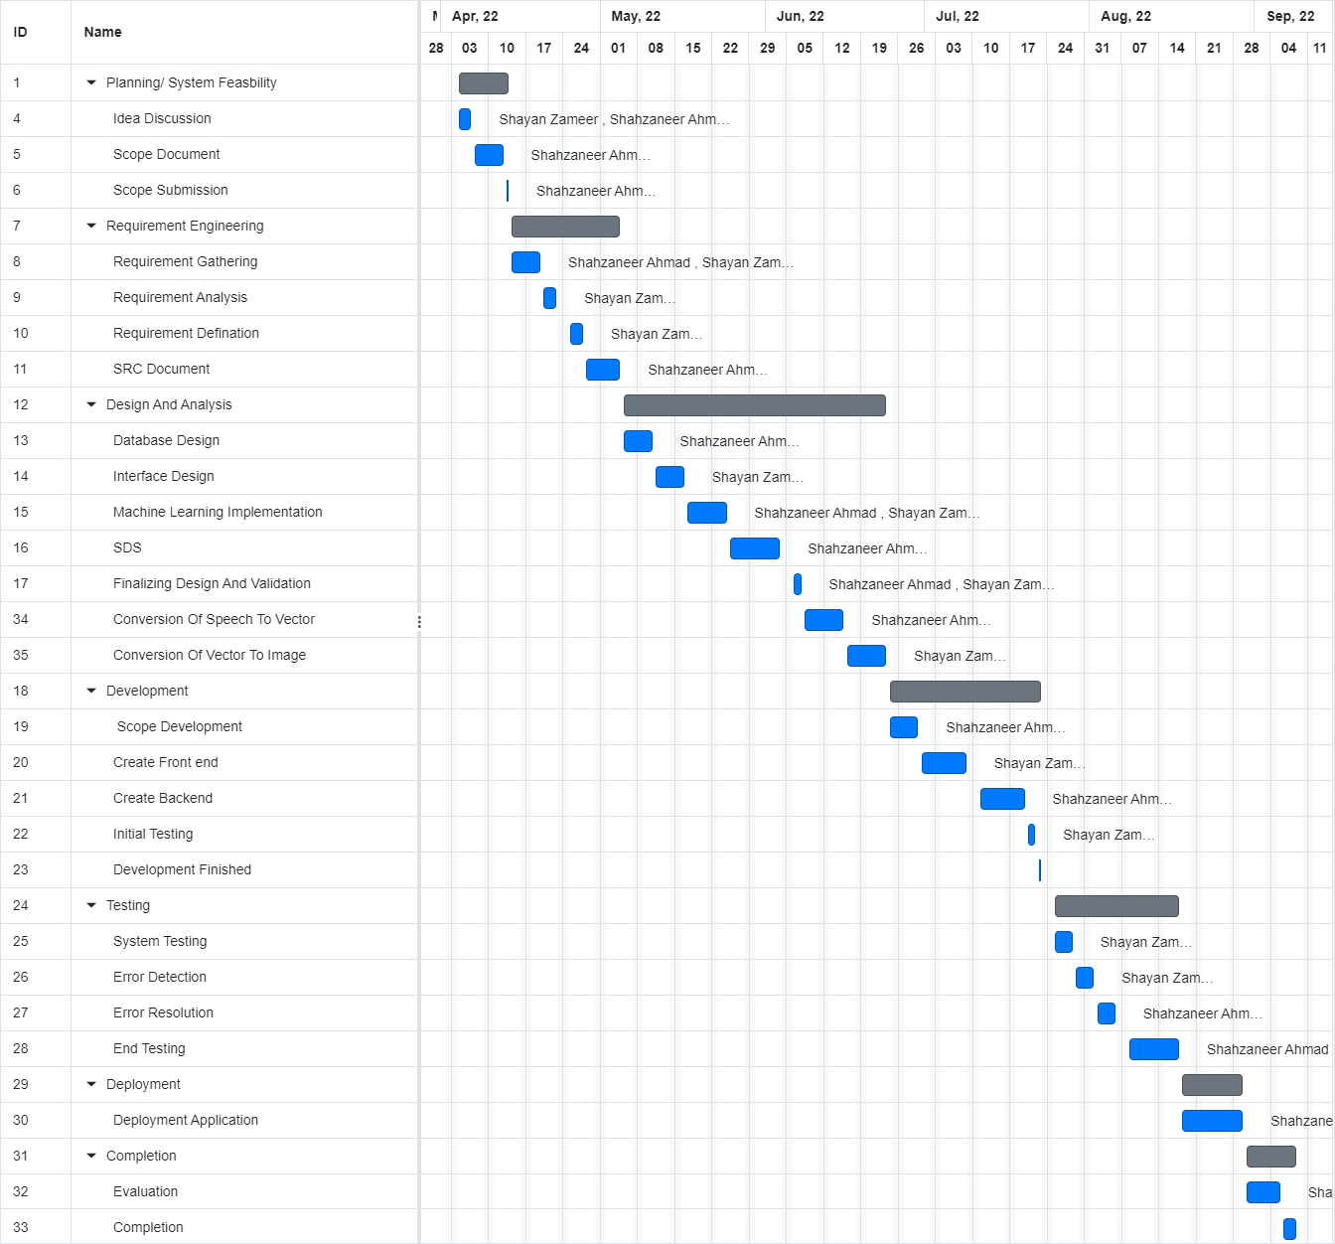
Gantt Chart
The Gantt Chart of the project is provided below:

Slide 31
SRS (System Requirement Specification)

Slide 32
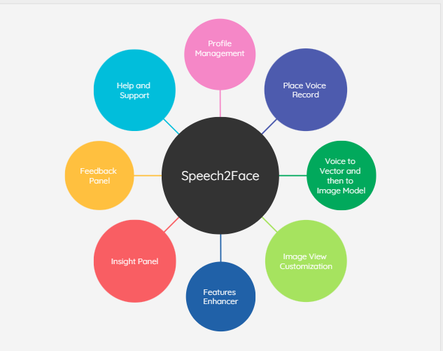
Context Diagram of Speech2Face
Figure 1 :Context Diagram Of Speech2Face

Slide 33
Requirement Elicitation Techniques
The requirement elicitation techniques are given below:
Observations.
Group discussion.
Studying related systems.
Questionnaires and Surveys.

Slide 34
List of Use Cases Module Wise Module-1: Profile Management
Module 1: Profile Management (Tabular Module 1.pdf)
Use Case Id | Use Case Title | Use Case Description | Functional Requirement
UC-1.1 | Signup | Users will have to create an account first | M1_UC1.pdf
UC-1.2 | Login | The users will log in to their accounts when they want to use it. | M1_UC2.pdf
UC-1.3 | Sign in via phone | User can sign in by using their phone. | M1_UC3.pdf
UC-1.4 | Sign in via voice | User can sign in by using their voice. | M1_UC4.pdf
UC-1.5 | Update Profile | User can update their profile. | M1_UC5.pdf

Slide 35
List of Use Cases Module Wise Module-1: Profile Management
Module 1: Profile Management (Tabular Module 1.pdf)
Use Case Id | Use Case Title | Use Case Description | Functional Requirement
UC-1.6 | Log out | User Can logout of their account | M1_UC6.pdf

Slide 36
List of Use Cases Module Wise Module-2: Place a Voice record
Module 2: Place a Voice Record
Use Case Id | Use Case Title | Use Case Description | Functional Requirement
UC-2.1 | Record voice | The user can record their voice. | M2_UC1.pdf
UC-2.2 | Upload Existing voice | The users can Upload existing voice. | M2_UC2.pdf
UC-2.3 | Upload Existing Video | The user can Upload existing video through which voice can be extracted. | M2_UC3.pdf
UC-2.4 | Update voice | The user has option to update voice. | M2_UC4.pdf
UC-2.5 | Update video | The user has option to update video. | M2_UC5.pdf
UC-2.6 | Delete Voice | Users can delete voices from saved voices folder. | M2_UC6.pdf
UC-2.7 | Delete Video | User can delete existing videos from saved video folder. | M2_UC7.pdf

Slide 37
List of Use Cases Module Wise Module-3: Sound to Vector Model
Module 3: Sound to Face Vector Model
Use Case Id | Use Case Title | Use Case Description | Functional Requirement
UC-3.1 | Sound to Vector via deep learning | In this use case voice will be converted to vector model usin Machine learning. | M3_UC1.pdf
UC-3.2 | Generate Vector Model | The Vector model can be generated | M3_UC2.pdf

Slide 38
List of Use Cases Module Wise Module-4: Vector to Image Model
Module 4: Vector to Image Model
Use Case Id | Use Case Title | Use Case Description | Functional Requirement
UC-4.1 | Vector to Image model via deep learning | In this use case vector will be converted to image model using Machine learning. | M4_UC1.pdf
UC-4.2 | Generate Image | The image can be generated | M4_UC2.pdf

Slide 39
List of Use Cases Module Wise Module-5: Image View Customization
Module 5: Image View Customization
Use Case Id | Use Case Title | Use Case Description | Functional Requirement
UC-5.1 | Brightness Control | User can control the brightness of image. | M5_UC1.pdf
UC-5.2 | Saturation Management | User can adjust saturation to image. | M5_UC2.pdf
UC-5.3 | Skin tone Management | User can adjust skin tone of image. | M5_UC3.pdf
UC-5.4 | Filters | User can apply filters to image. | M5_UC4.pdf
UC-5.5 | Avatar maker | User can make avatar. | M5_UC5.pdf

Slide 40
List of Use Cases Module Wise Module-6: Features Enhancement
Module 6: Features Enhancement
Use Case Id | Use Case Title | Use Case Description | Functional Requirement
UC-6.1 | Edit Picture | Security person can edit image. | M6_UC1.pdf
UC-6.2 | Nose Enhancement | Security person can enhance Nose. | M6_UC2.pdf
UC-6.3 | Eye Enhancement | Security person can enhance eye. | M6_UC3.pdf
UC-6.4 | Eyebrow Enhancement | Security person can enhance eyebrow. | M6_UC4.pdf
UC-6.5 | Beard Maker | Security person can make beard of person. | M6_UC5.pdf

Slide 41
List of Use Cases Module Wise Module-7: Insight Panel
Module 7: Insight Panel
Use Case Id | Use Case Title | Use Case Description | Functional Requirement
UC-7.1 | View report | Security person can view report. | M7_UC1.pdf
UC-7.2 | Download report | Security Person can download report. | M7_UC2.pdf
UC-7.3 | Share via Socials | Security person can share reports to social. | M7_UC3.pdf

Slide 42
List of Use Cases Module Wise Module-8: Help And Support
Module 8: Help And Support
Use Case Id | Use Case Title | Use Case Description | Functional Requirement
UC-8.1 | Chat With AI Bot | Users can chat with bot to get instant automated answers. | M8_UC1.pdf
UC-8.2 | Contact Support Team | Users can contact support team. | M8_UC3.pdf
UC-8.3 | Change Bot’s Language | Users can change bot language including Urdu and English. | M8_UC5.pdf
UC-8.4 | View Bot Query History | The user will be able to view the history of their queries with the bot. | M8_UC6.pdf

Slide 43
List of Use Cases Module Wise Module-9: Settings and Configuration
Module 8: Settings and Configuration
Use Case Id | Use Case Title | Use Case Description | Functional Requirement
UC-9.1 | Sent Feedback | Users can chat with bot to get instant automated answers. | M9_UC1.pdf
UC-9.2 | Contact Support Team | Users can contact support team. | M9_UC2.pdf
UC-9.3 | View Feedback History | Users can see the history of feedbacks sent by the user. | M9_UC3.pdf
UC-9.4 | Dark mode | The user will be able to apply dark mode on application | M9_UC4.pdf

Slide 44
List of Use Cases Module Wise Module-9: Settings and Configuration
Module 8: Settings and Configuration
Use Case Id | Use Case Title | Use Case Description | Functional Requirement
UC-9.5 | Change Language | Users can change the language of application. | M9_UC5.pdf
UC-8.2 | Privacy Policy | Users can read the privacy policy of the system. | M9_UC6.pdf

Slide 45
Non-Functional Requirement
The Non-Functional Requirements are provided below:
Title | Performance Requirements
NFR-1 | The system will have a minimum response time of 1.5 second and maximum response time of 5 seconds. After reaching 5 seconds limit, user will receive a prompt message and previous activity will be restored.
Title | Reliability
NFR-2 | MTBF (Mean Time between Failures): The estimated mean time between failures will be 24 hours ÷ 4 Errors. So, the estimated MTBF value is 6. Consequences of the Software Failure: Even if the software fails due to an error, the user will not lose his/her data. Every detail of the user’s data will be recovered because the backup system of software will always update the backup file after every change the user made in his/her profile. So incase the system fails, the backup program will execute automatically to recover all the data. Protection from Failure: At the testing phase of the Software development, the software would be thoroughly checked before going on to the next phase. So, there would be a 10% chance that an error could be faced by any user. Strategy for Correction: As the design methodology that will be used is Object Oriented, so even if the error shows up, it will be easier to detect the line of code where the bug is present. So, the average time to fix an error would be 3-4 hours.

Slide 46
Non-Functional Requirement
Titles | Usability
NFR-3 | Use-1: A new user of the software will take only 20-30 minutes to understand the use of the system. Use-2: The software will be easy to use, and the users will not have to add their credentials again and again because the credentials will be saved when the user adds them for the first time on choice. Use-3: The interface of the system will also be easy to use. Users can easily switch menus and understand it without any problem because every menu has a simple interface. Use-4: The lost data of the user can be recovered through the backup system. The probability of data recovery is 90%.
Title | Security
NFR-4 | The system will ensure the security of data and information of users. The credentials of Users are safe.

Slide 47
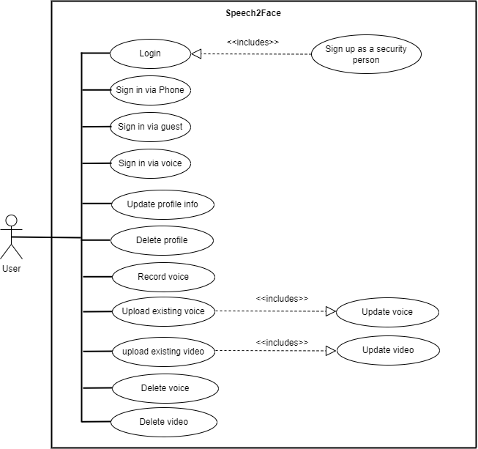
Use Case Diagram For Users
Figure 2 :Use Case Diagram of Module 1 and 2

Slide 48
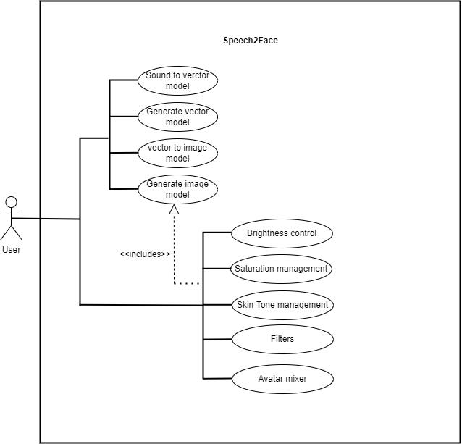
Use Case Diagram For Users
Figure 3 :Use Case Diagram of Module 3 , 4 and 5

Slide 49
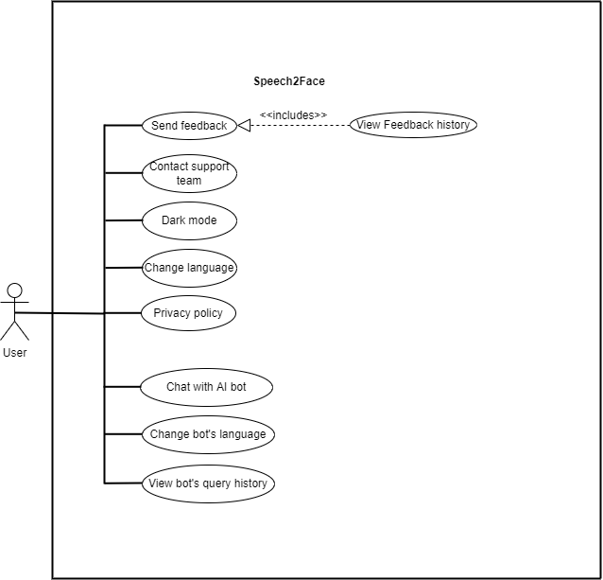
Use Case Diagram For Users
Figure 4 :Use Case Diagram of Module 8 and 9

Slide 50
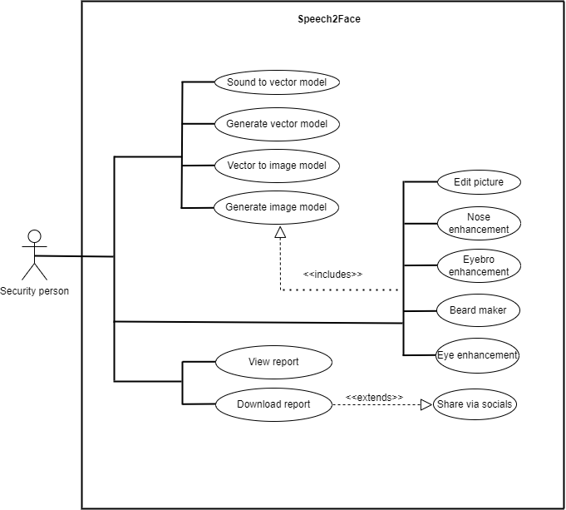
Use Case Diagram For Security Person
Figure 5 :Use Case Diagram of Module 3,4, 6 and 7

Slide 51
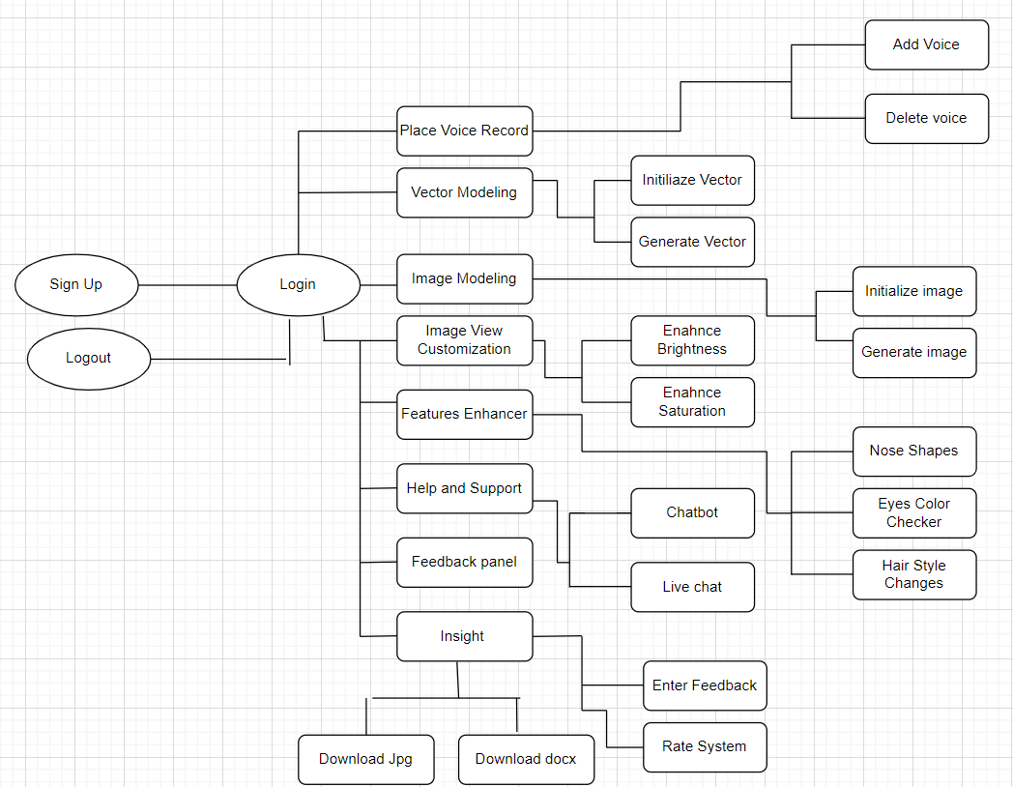
Process Flow Diagram of Proposed Project
The process flow diagram is as follows:
Figure 6: Process Flow Diagram – System Interaction For User.

Slide 52
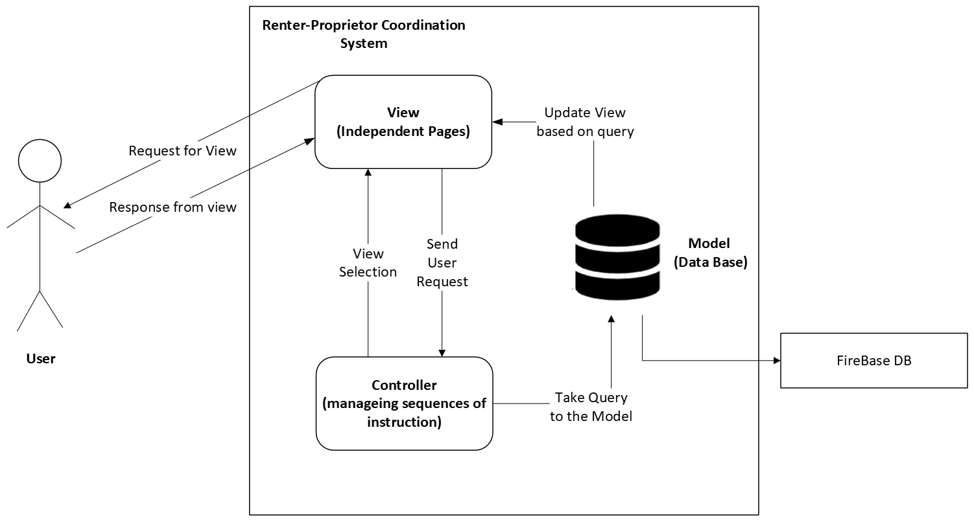

Architecture Diagram of Proposed Project
The Architecture style we are using will be Model View Controller (MVC).
Figure 7: MVC Architecture Diagram

Slide 53
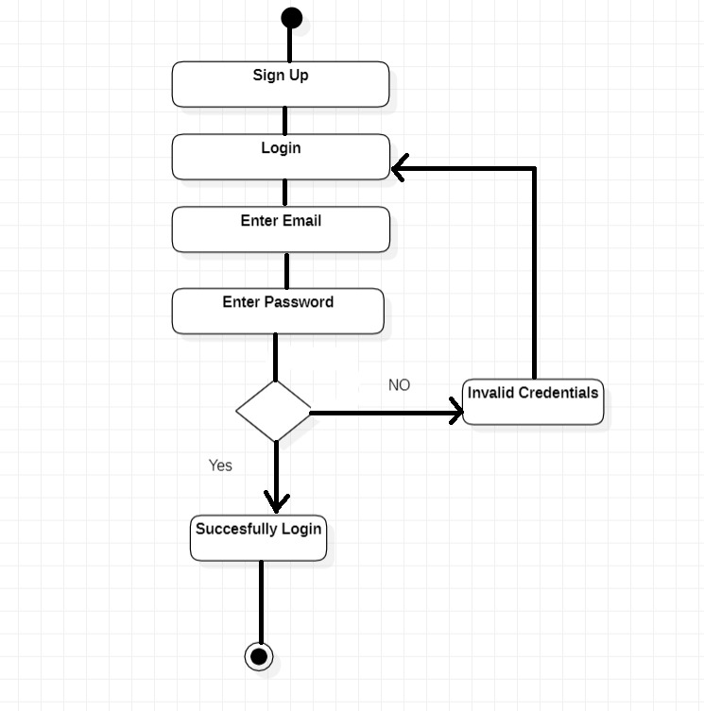
Activity Diagrams
Figure 8 : Activity Diagram for Module 1

Slide 54
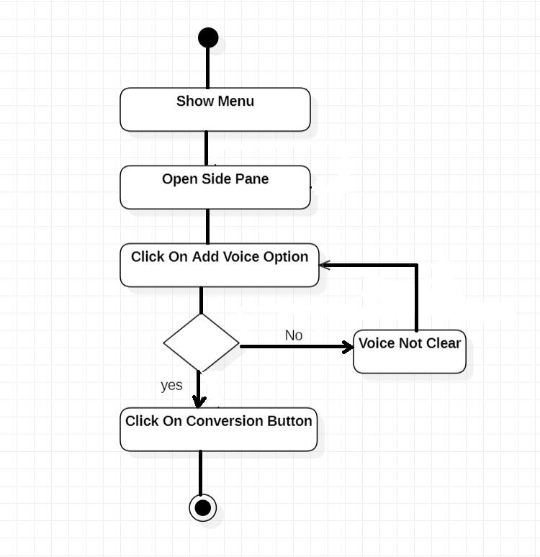
Activity Diagrams
Figure 9 : Activity Diagram Module 2

Slide 55
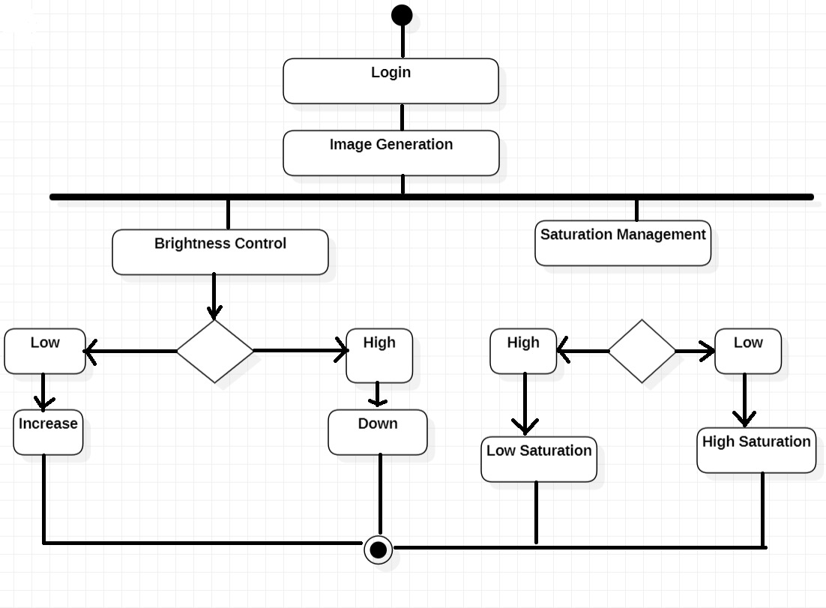
Activity Diagrams
Figure 10 : Activity Diagram of Module 5

Slide 56
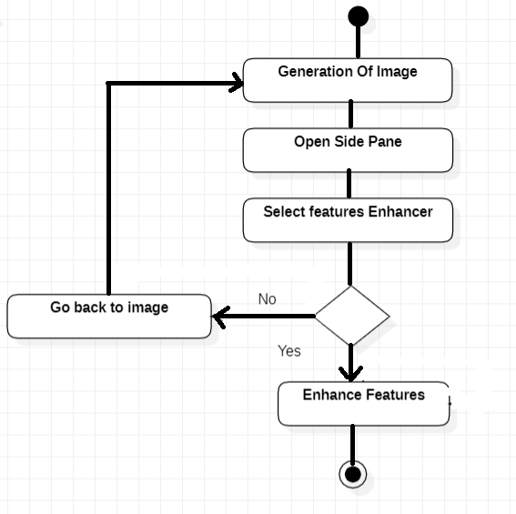
Activity Diagrams
Figure 11: Activity Diagram of Module 6

Slide 57
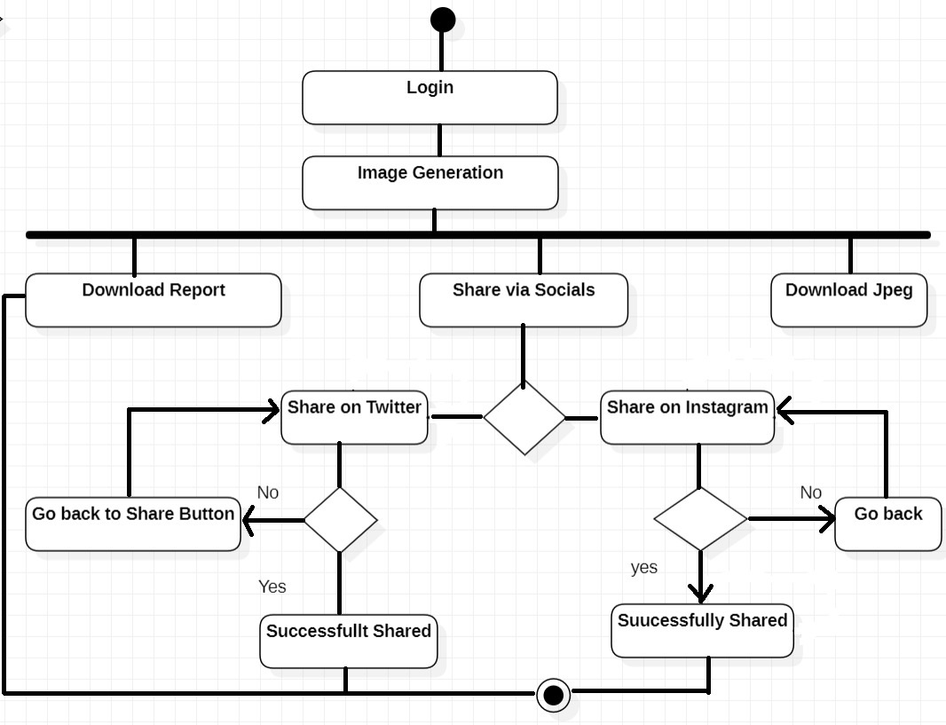
Activity Diagrams
Figure 12: Activity Diagram of Module 7

Slide 58
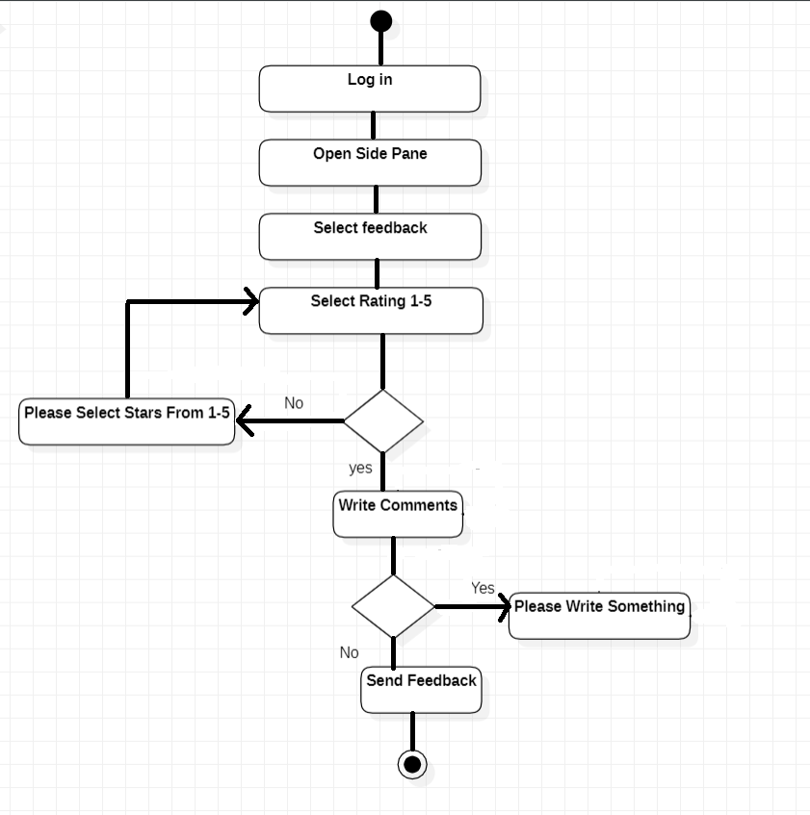
Activity Diagrams
Figure 13: Activity Diagram of Module 8

Slide 59
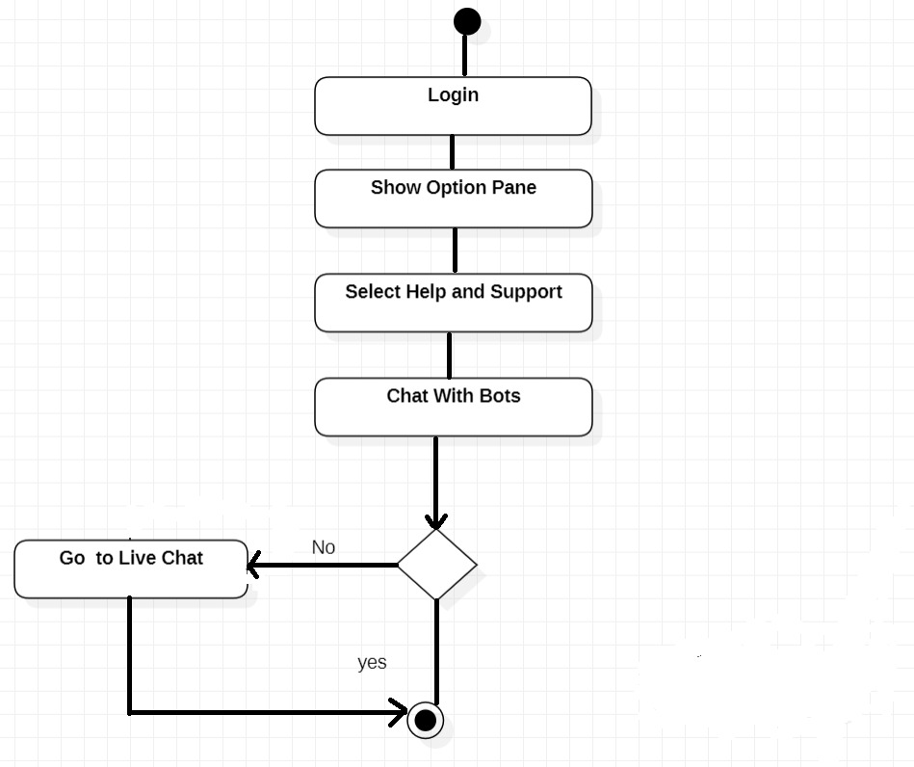
Activity Diagrams
Figure 14 : Activity Diagram of Module 9

Slide 60
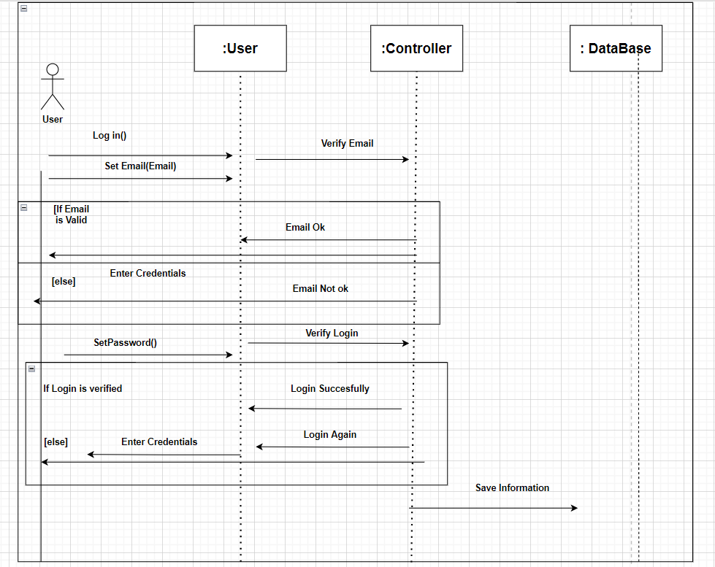
Sequence Diagram
Figure 15 : Sequence Diagram of Module 1

Slide 61
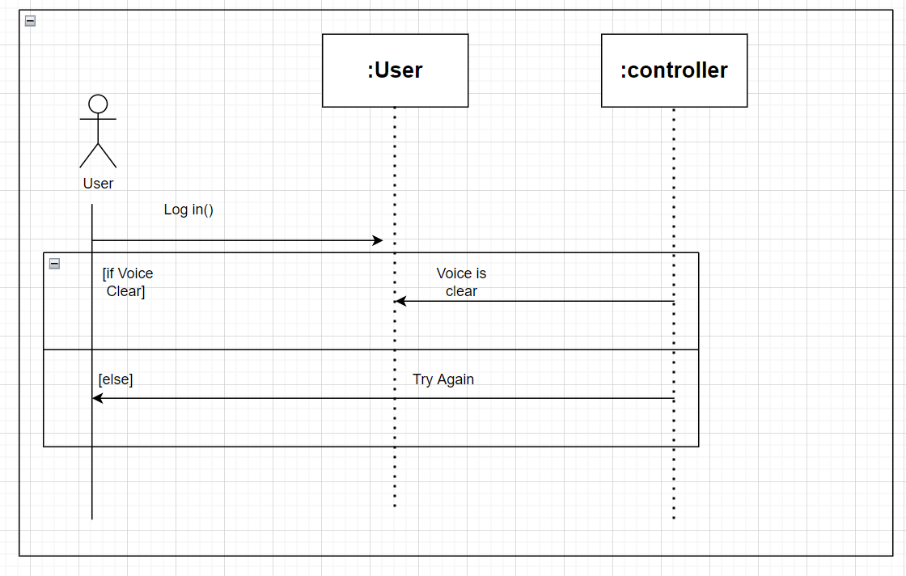
Sequence Diagram
Figure 16: Sequence Diagram of Module 2

Slide 62
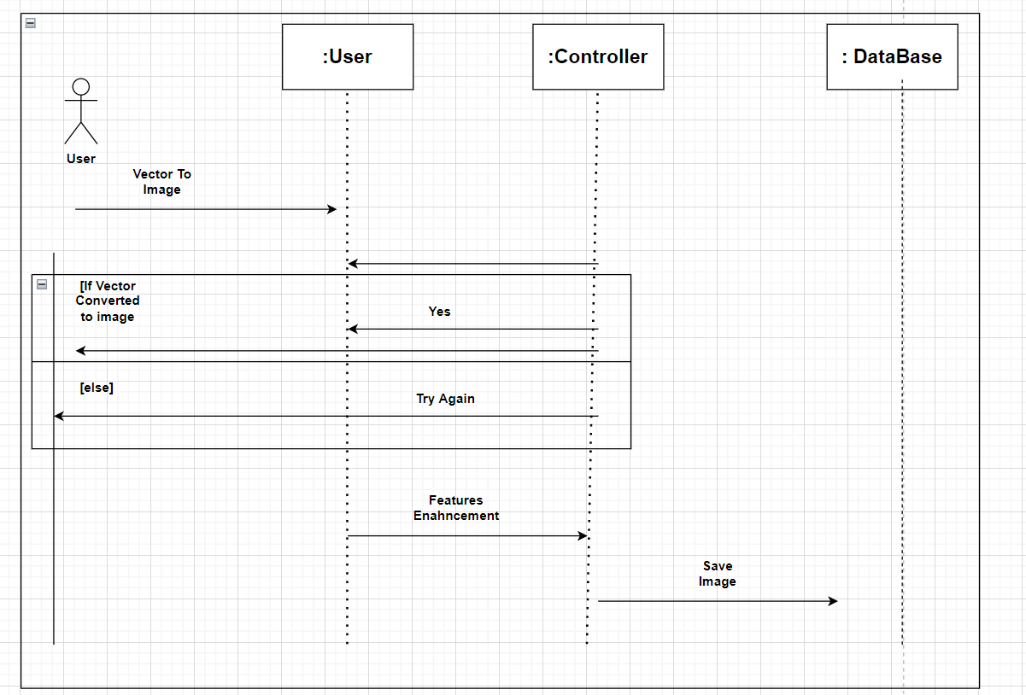
Sequence Diagram
Figure 17: Sequence Diagram of Module 6

Slide 63
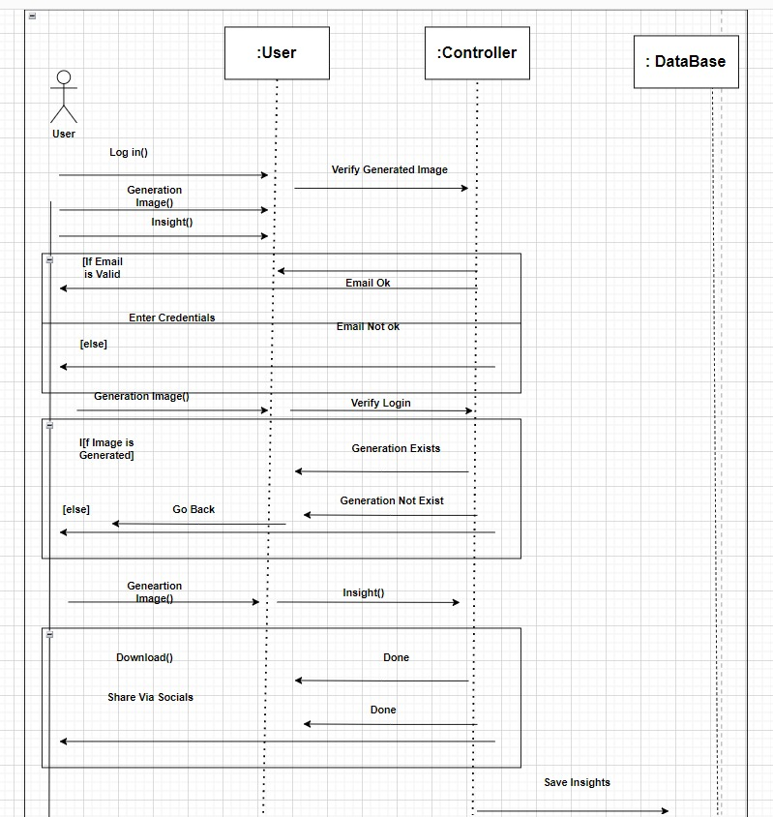
Sequence Diagram
Figure18 : Sequence Diagram of Module 7

Slide 64
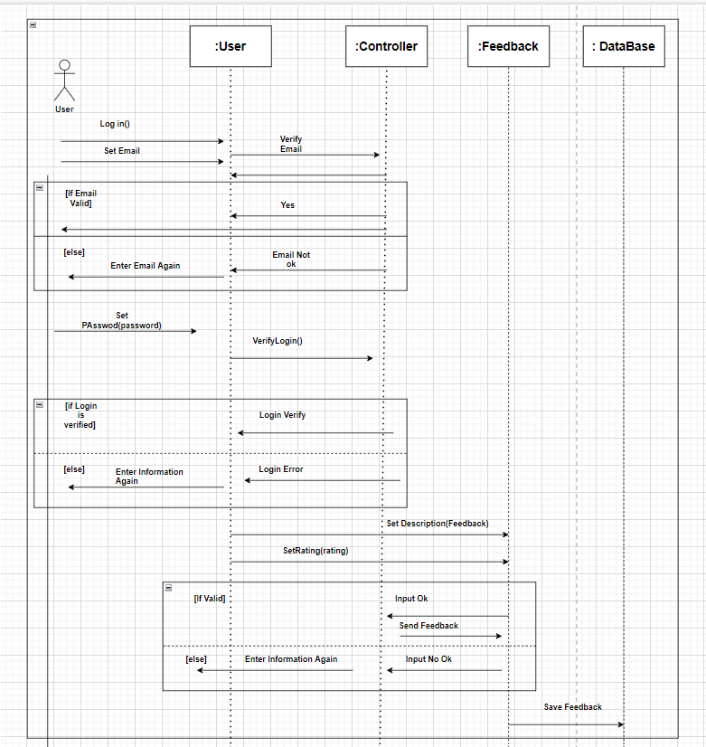
Sequence Diagram
Figure 19: Sequence Diagram of Module 8

Slide 65
Sequence Diagram
Figure 20 : Sequence Diagram of Module 8

Slide 66
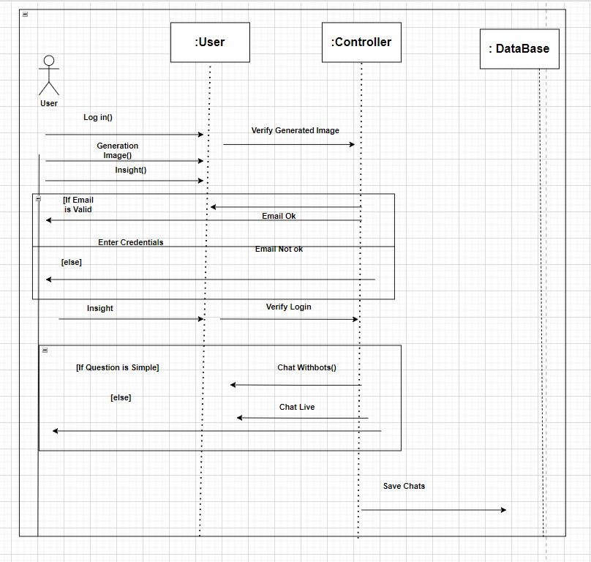
Sequence Diagram
Figure 21: Sequence Diagram of Module 9

Slide 67
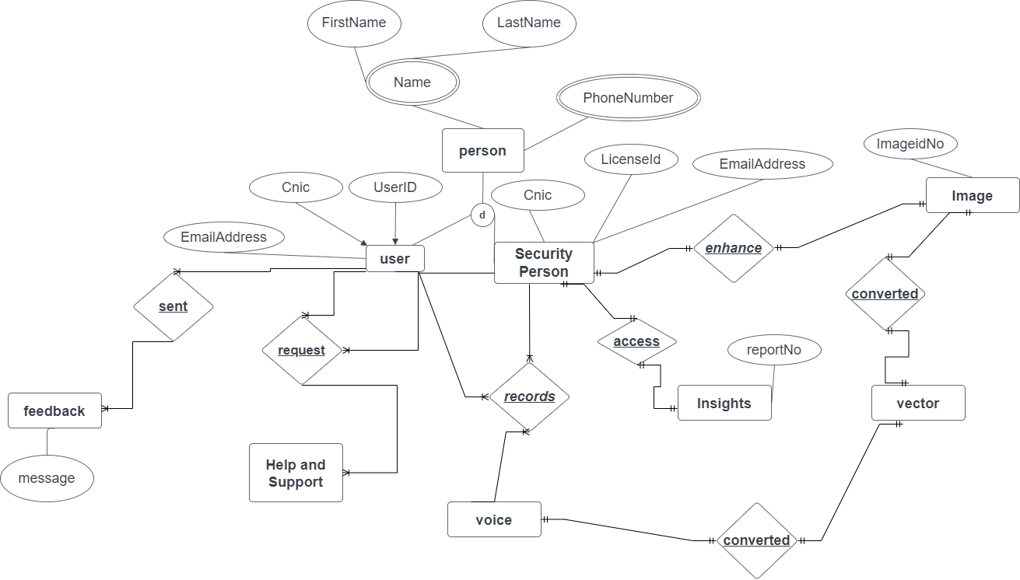
Entity Relationship Diagram
Figure 22: Entity Relationship Diagram of Speech2Face Application

Slide 68
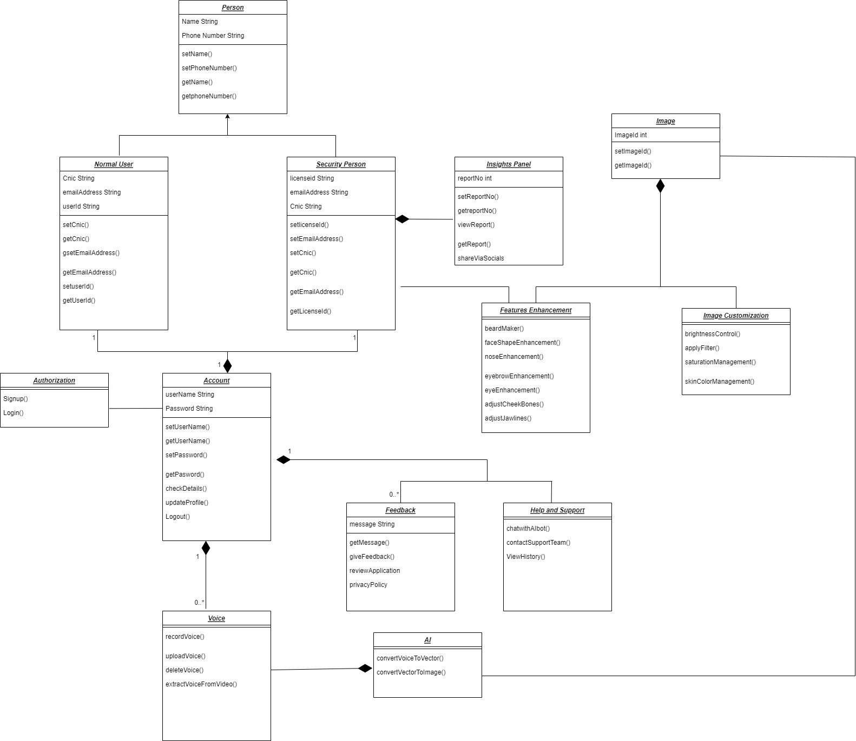
Class Diagram
Figure 23: Class Diagram of Speech2Face Application

Slide 69
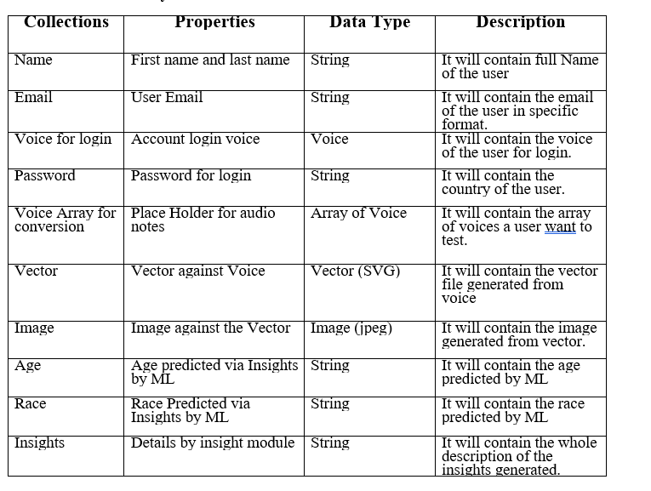
Data Design

Slide 70
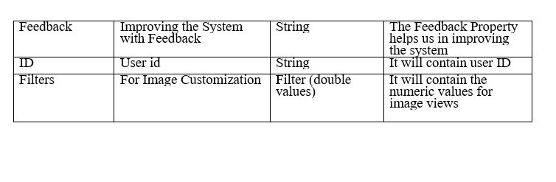
Data Design

Slide 71
Algorithms And Implementation

Slide 72
Algorithm & Implementation
1) Sign up and Login
DO
INPUT email
IF(verifyEmail NOT EQUAL true)
DISPLAY “Invalid Email”
WHILE (verifyEmail EQUAL false)
INPUT password
IF(account NOT found)
DISPLAY “Invalid login credentials! Please try again!”
ELSE
DISPLAY “Successfully logged in!”
2) Adding Voice Record
IF(login)
DO
INPUT Voice Record
INPUT User Id
if(voice Not deleted)
Display”Voice saved”

Slide 73
Algorithm & Implementation
3) Voice to Vector Modeling
If(login && voiceSaved)
Initialize Vector Modeling
While(!Modeling Successful)
Initialize Again
I
Else
Generate Vector)
4) Vector to Image Modeling
If(login && voiceSaved)
Initialize Vector Modeling
While(!Modeling Successful)
Initialize Again
I
Else
Generate Vector)

Slide 74
Algorithm & Implementation
5) Image View Customization
IF(login && imageSaved)
Show Customization
If (Cutomizedbutton clicked)
Show customized screen
WHILE(Broghtness|| saturation|| hue)
Set Controller;
Modify image;
Display Image

Slide 75
Algorithm & Implementation
5) Image View Customization
IF(login && imageSaved)
Show Customization
If (Cutomizedbutton clicked)
Show customized screen
WHILE(Broghtness|| saturation|| hue)
Set Controller;
Modify image;
Display Image

Slide 76
Testing

Slide 77
Test Items
The Items to be tested are given below:
Use Cases of each module
Requirement Specifications
Design Specifications
User Guides
Operation Manuals
Installation Manuals
Usability
Performance
Security
Compatibility
Reliability

Slide 78
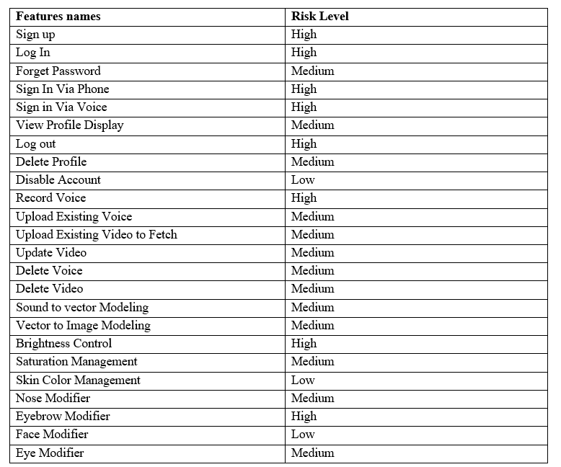
Features to Be Tested

Slide 79
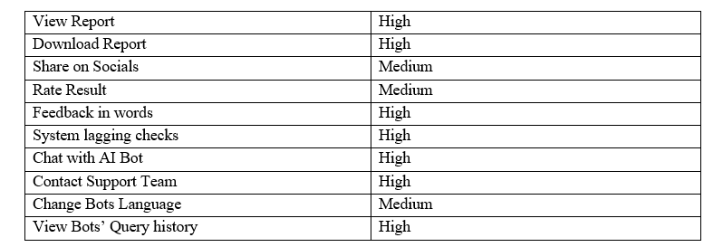
Features to Be Tested

Slide 80
Item Pass/Fail Criteria
Unit Level:
Test Passing: The test is declared passed if 80% of the test cases are completed and tested with less than 5% of defects rate.
Test Failure: The test is declared failed if 80% of the test cases are completed and tested with more than 5% of defects rate.
Low Level Tests:
Test Accomplishment: Low level tests will be accomplished if 90% of the plans are successfully completed without major bugs and defects.
Bugs Acceptability: Maximum number of 6 bugs are allowed in the plan. The test with medium or major bugs are failed.

Slide 81
Item Pass/Fail Criteria
High Level Tests:
Test Accomplishment: The high level test are said to be completed when the system runs successfully and efficiently and produce the required result with minimal bugs.
Bugs Acceptability: Minor bugs and defects are acceptable if they do not cause the failure of the system or crashing.

Slide 82
Item Pass/Fail Criteria
Application
The application will receive a Passed status if it accomplishes in producing more than 85% accurate results.
The application will receive a failed status if it produces less than 85% accurate results.
Data Conversion
Success criteria for data conversion are outlined in the Data Conversion Plan.

Slide 83
Test Deliverables
Test deliverables of the document are:
Test plan
Data gathering, testing models and philosophy, experiments, and an arrangement for directing tests are all important for this interaction.
Test design specifications
The test plan-close to the system used to make and run the tests are associated with this deliverable.
Test case specifications
The conditions and criteria for the results, along with the specifications of the functionalities that were tested, are included.
Test procedure specifications
It incorporates the picked sort of testing strategy. For instance, our picked type is dim box testing since it remembers effective and exhaustive testing for both interior and outer degree of the item.
Test item transmittal reports
List of entities to be tested are included.
Test logs
The test data and received outcomes are included.
Test Incident Reports
Any defects/ bugs and abnormality found in behavior of the app are included.
Test Summary reports
A brief overview of whole procedure with statistical data is included.

Slide 84
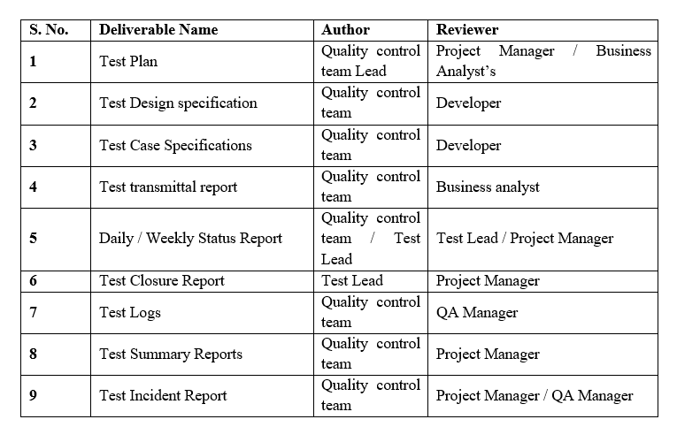
Test Tasks

Slide 85
Environmental Needs
Following are the environmental needs for carrying out our test plan:
Stable internet connection for both mobile and web applications
Devices with Android 6 and above, or iOS 11 and above.
Web browsers that support HTML 5.
The Data should already be trained for the desired region and race of humans.

Slide 86
Testing Methodology
Grey Box Testing | Testing is done at internal level of the code as well as outer level
Verification | All the processes cycle of the system are tested thoroughly to make sure that the system is bug free as much as possible. All the prepared documents, design and code are tested to check whether they are according to the requirements or not. All the security measures are evaluated in detail. The data from each user needs to be verified because the app has to deal with it.
Validation | The key objective of validation is to make sure that whether the product being built is according to the user requirements or not. So, validation of the system is done make sure that all the built product is in accordance with the user requirements.
Usability Testing | The features and uses of the system are checked whether they are user-friendly or not. The usability will be tested to make sure that the end-user can understand the product easily. As the system will be used by both technical and non-technical users, they should not face any major bugs.

Slide 87
Testing Methodology
Verification | All the processes cycle of the system are tested thoroughly to make sure that the system is bug free as much as possible. All the prepared documents, design and code are tested to check whether they are according to the requirements or not. All the security measures are evaluated in detail. The data from each user needs to be verified because the app has to deal with it.
Validation | The key objective of validation is to make sure that whether the product being built is according to the user requirements or not. So, validation of the system is done make sure that all the built product is in accordance with the user requirements.
Usability Testing | The features and uses of the system are checked whether they are user-friendly or not. The usability will be tested to make sure that the end-user can understand the product easily. As the system will be used by both technical and non-technical users, they should not face any major bugs.

Slide 88
Testing Methodology
Module / Unit Testing | It is the most basic level of testing. So, each functional requirement is tested individually by the group members. The functional requirements of each module are tested. Most of the bugs can be found in this phase because each basic functional requirement is checked thoroughly.
Integration Testing | Integration level testing is done to make sure that the modules and major components of the system are working properly as an entire entity. Testing is done to detect all kinds of major and minor bugs.
System Testing | In system level testing, the system is tested as a whole after the implementation of each module. Unusual operations are performed to find any bugs or failure of the system. The functionalities of the system are tested to ensure that the system’s result satisfy the user requirements.
Acceptance Testing | The software is deployed to the users or clients, and it will be checked whether the system is accepted by them or not. It is also made sure that the system is fulfilling their requirements.

Slide 89
List of Test Cases Module-1: Profile Management
Module 1: Profile Management (Tabular Module 1.pdf)
Test Case Id | Test Case Title | Test Case Description | Test Case Details
TC-1.1 against UC-1.1 | Verify Signup | Users will have to create an account first | M1_UC 1.1 .pdf
TC-1.2 against UC-1.2 | Verify Login | The users will log in to their accounts when they want to use it. | M1_UC 1.2.pdf
TC-1.3 against UC-1.3 | Verify Sign Via Phone | The User has option to sign in by using Phone. | M1_UC 1.3.pdf
TC-1.4 against UC-1.4 | Verify Sign In Via voice | The User has option to sign in by using voice | M1_UC 1.4.pdf
TC-1.5 against UC-1.5 | Update Profile | User can update their profile. | M1_UC 1.5.pdf

Slide 90
List of Test Cases Module-1: Profile Management
Module 1: Profile Management (Tabular Module 1.pdf)
Test Case Id | Test Case Title | Test Case Description | Test Case Details
TC-1.6 against UC-1.6 | Verify Logout | User Can Logout from system | M1_UC 1.6.pdf

Slide 91
List of Test Cases Module-2: Place A Voice Record
Module 2: Place A Voice Record (Tabular Module 2.pdf)
Test Case Id | Test Case Title | Test Case Description | Test Case Details
TC-2.1 against UC-2.1 | Check Record Voice | User can record voice | M2_UC 2.1.pdf
TC-2.2 against UC-2.2 | Verify Upload existing Voice | User can Upload existing voices | M2_UC2.2.pdf
TC-2.3 against UC-2.3 | Verify Upload Existing Video | User can Upload Existing videos | M2_UC2.3.pdf
TC-2.4 against UC-2.4 | Verify Update Voice | User can Update existing voices | M2_UC2.4.pdf
TC-2.5 against UC-2.5 | Verify Update Video | User can Update Video | M2_UC2.5.pdf
TC-2.6 against UC-2.6 | Verify Delete Video | The user can delete video whenever he/she wants to | M2_UC2.6.pdf
TC-2.7 against UC-2.7 | Verify Delete Video | The User can delete videos whenever he/she wants | M2_UC2.7.pdf

Slide 92
List of Test Cases Module-3: Sound to Vector Model
Module 3: Sound to Vector Model (Tabular Module 3.pdf)
Test Case Id | Test Case Title | Test Case Description | Test Case Details
TC-3.1 against UC-3.1 | Verify Sound to Vector Model | User Can convert sound to Vector first | M1_UC 3.1.pdf
TC-3.2 against UC-3.2 | Verify Generate Vector Model | User can generate Vector Model | M1_UC 3.2.pdf

Slide 93
List of Test Cases Module-4: Vector to Image Model
Module 4: Vector to Image Model (Tabular Module 4.pdf)
Test Case Id | Test Case Title | Test Case Description | Test Case Details
TC-4.1 against UC-4.1 | Verify Vector to image Model | User Can convert vector to Image first | M1_UC 4.1.pdf
TC-4.2 against UC-4.2 | Verify Generate Image Model | User can generate Image Model | M1_UC 4.2.pdf

Slide 94
List of Test Cases Module-5: Vector to Image Model
Module 5: Vector to Image Model (Tabular Module 5.pdf)
Test Case Id | Test Case Title | Test Case Description | Test Case Details
TC-5.1 against UC-5.1 | Verify Brightness Control | User Can adjust brightness of image | M1_UC 5.1.pdf
TC-5.2 against UC-5.2 | Verify Saturation Management | User can adjust Saturation of Image | M1_UC 5.2.pdf
TC-5.3 against UC-5.3 | Verify Skin tone Management | User Can adjust skin tone of image | M1_UC 5.3.pdf
TC-5.4 against UC-5.4 | Verify Filters | User can adjust Filters to Image | M1_UC 5.4.pdf
TC-5.5 against UC-5.5 | Verify Avatar Maker | User can make avatar of Image | M1_UC 5.5.pdf

Slide 95
List of Test Cases Module-6: Features Enhancement
Module 6: Features Enhancement (Tabular Module 6.pdf)
Test Case Id | Test Case Title | Test Case Description | Test Case Details
TC-6.1 against UC-6.1 | Check Face shape Management | User Can enhance the image of image | M1_UC 6.1.pdf
TC-6.2 against UC-6.2 | Check nose Enhancement | User can enhance the nose of Image | M1_UC 6.2.pdf
TC-6.3 against UC-6.3 | Check eyebrow Enhancement | User can enhance the eyebrow of image | M1_UC 6.3.pdf
TC-6.4 against UC-6.4 | Check Beard Maker | User can make beard of image | M1_UC 6.4.pdf
TC-6.5 against UC-6.5 | Check Eye Enhancement | User can enhance the eyes of image | M1_UC 6.5.pdf

Slide 96
List of Test Cases Module-7: Insight Panel
Module 1: Insight Panel (Tabular Module 7.pdf)
Test Case Id | Test Case Title | Test Case Description | Test Case Details
TC-7.1 against UC-7.1 | Check View Report | User Can check the report | M1_UC 7.1.pdf
TC-7.2 against UC-7.2 | Check Download report | User can download report | M1_UC 7.2.pdf
TC-7.3 against UC-7.3 | Check share via socials | User can share insights on socials. | M1_UC 7.3.pdf

Slide 97
List of Test Cases Module-8: Setting and Configuration
Module 1: Setting and Configuration (Tabular Module 8.pdf)
Test Case Id | Test Case Title | Test Case Description | Test Case Details
TC-8.1 against UC-8.1 | Check System Rating | User Can rate the system | M1_UC 8.1.pdf
TC-8.2 against UC-8.2 | Check sent Feedback | User can sent feedback. | M1_UC 8.2.pdf
TC-8.3 against UC-8.3 | System lagging Checks | System lagging checks. | M1_UC 8.3.pdf

Slide 98
List of Test Cases Module-9: Help and Support
Module 1: Help and Support(Tabular Module 9.pdf)
Test Case Id | Test Case Title | Test Case Description | Test Case Details
TC-9.1 against UC-9.1 | Verify chat with AI bot | User Can chat with AI bot. | M1_UC 9.1.pdf
TC-9.2 against UC-9.2 | Check contact support team | User can contact support team.. | M1_UC 9.2.pdf
TC-9.3 against UC-9.3 | Verify change bot’s Language | User can change the bot’s language. | M1_UC 9.3.pdf
TC-9.4 against UC-9.4 | Verify Bot’s Query | User can view Bot’s query history. | M1_UC 9.4.pdf

Slide 99
Lesson Learnt
Shahzaneer Ahmad (SP21-BCS-087) | Shayan Zameer (SP21-BCS-088)
Technical Aspect I learned the difference between the big debate BCS vs BSE as a major. I learned that I am more interested in Software Engineering as a major with a slight interest in other CS domains. I learned UI Designing using Figma and developed the UI of my First Application. Got to know about the SDLC Life Cycle which is going to help me throughout my journey in Software Engineering as a Career. I learned about Software Testing in detail and the career opportunities besides coding jobs. I learned about Flutter Application development with MVVM architecture and good coding practices along with design patterns. | My Presentation Documentation preparation skills were enhanced. During this project I learnt HTML CSS. I learnt how to use Figma and create UI of Mobile and web applications. Polished my team working skills in handling bigger projects like Speech2Face System. I learned about Software Testing in detail and the career opportunities. Stress Management while dealing with the tight deadlines and work under pressure.

Slide 100
Lesson Learnt
Shahzaneer Ahmad (SP21-BCS-087) | Shayan Zameer (SP21-BCS-088)
I learned how to use Firebase for authentication and database I learned to use Dialog flow for training my chatbot and its integration in Flutter App. Non-Technical Aspect I learned Leadership Skills while leading the project work throughout the semester. Stress Management while dealing with the tight deadlines and work under pressure. Improved my decision-making capability while working on different modules. Enjoyed the trip to Mabali Island and learned we should have separate time for enjoying life too. I started believing more in myself as I used to a semester ago.

Slide 101

Mockups
Mobile Application Mockups are:
Figure 24: Splash Screen Mockup

Slide 102
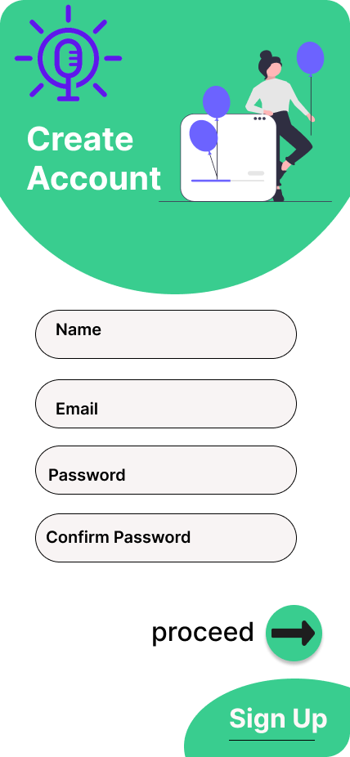
Mockups
Mobile Application Mockups are:
Figure 25 : Sign Up Screen Mockup

Slide 103
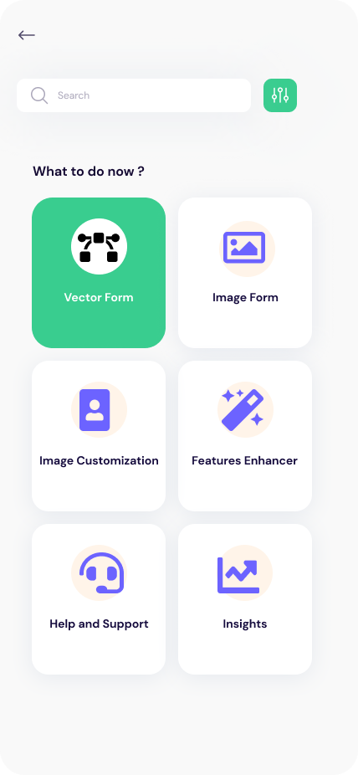
Mockups
Mobile Application Mockups are:
Figure 26: Home Screen Mockup

Slide 104
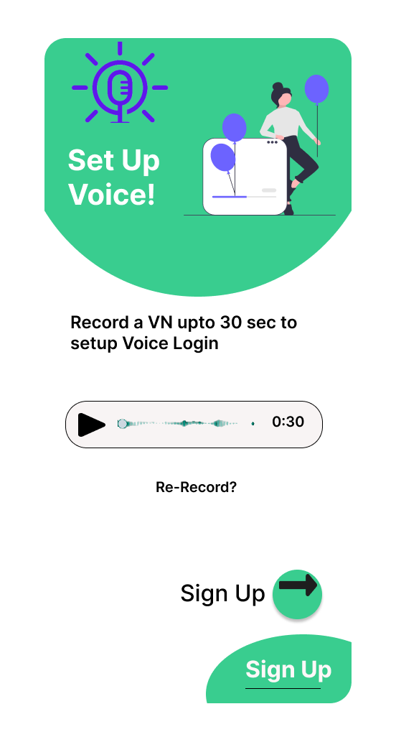
Mockups
Mobile Application Mockups are:
Figure 27: Add Voice Mockup

Slide 105
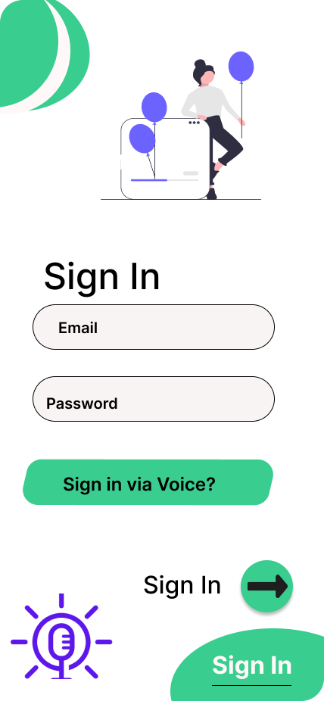
Mockups
Mobile Application Mockups are:
Figure 28: Sign in Mockup

Slide 106
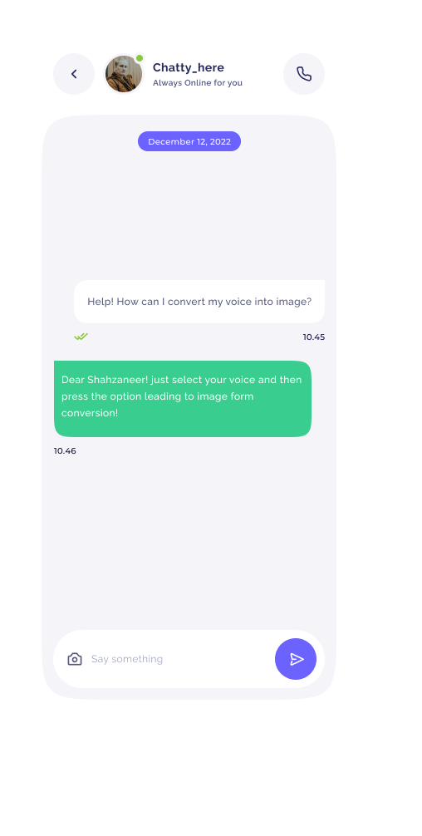
Mockups
Mobile Application Mockups are:
Figure 29: ChatBox Mockup

Slide 107
Conclusion
This Software Speech2face aims to help the security agencies to identify the culprits and the criminals so that the ratio of crime could be normalize.
It helps its general users to predict the image from voice.
As it is an R & D product so it is subjected to improvement with the feedback and the research process.

Slide 108
References
Related Systems:
https://www.github.com/topics/sound-classification.
https://speech2face.github.io/
Google Facenet
Youtube Resources:
https://www.youtube.com/watch?v=aKYlSIs3UDY&t=334s

Slide 109

Questions and Answers

